Slide 1
UART – RX & TX

Slide 2
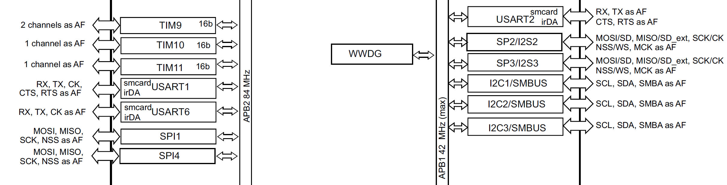
Universal synchronous asynchronous receiver transmitter (USART2)

Slide 3
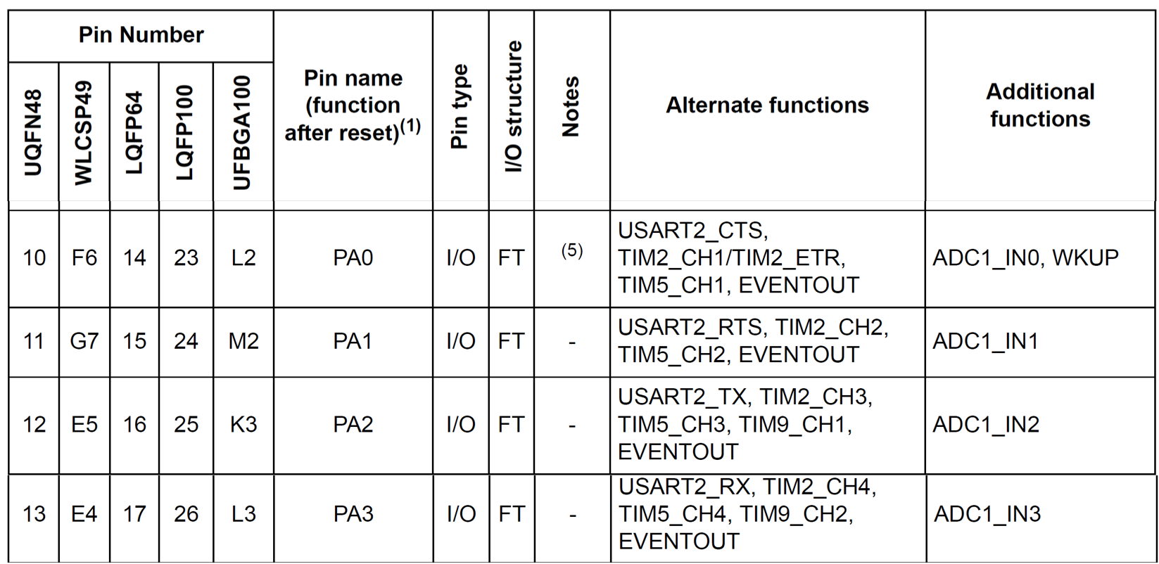
UART Ports

Slide 4
USART registers

Slide 5
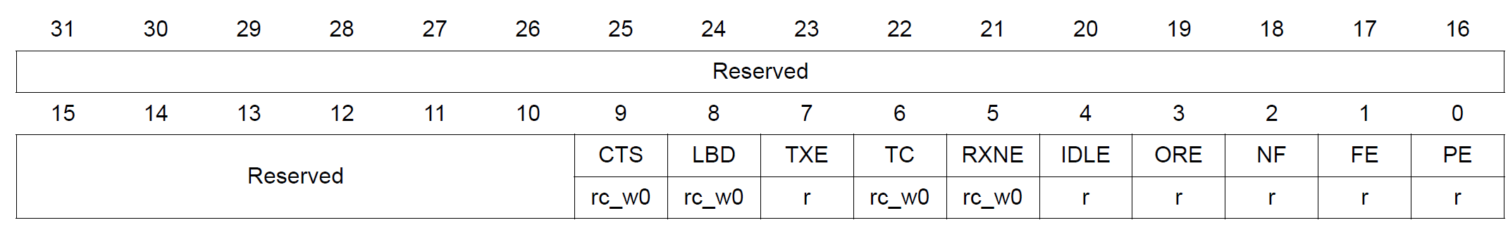
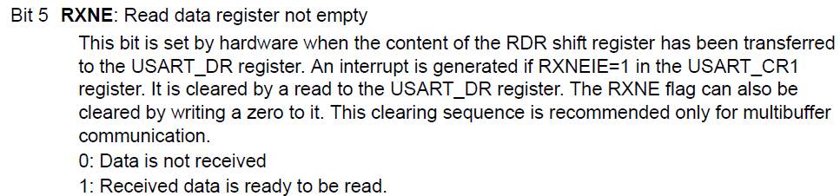
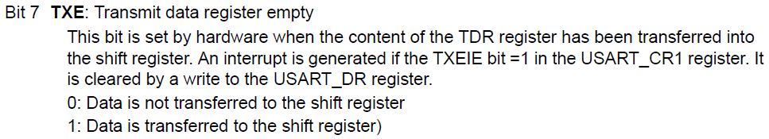
Status register (USART_SR)

Slide 6
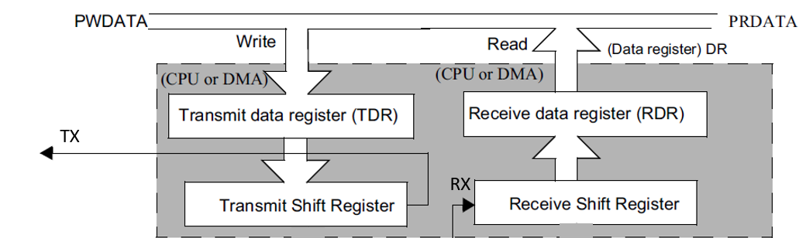
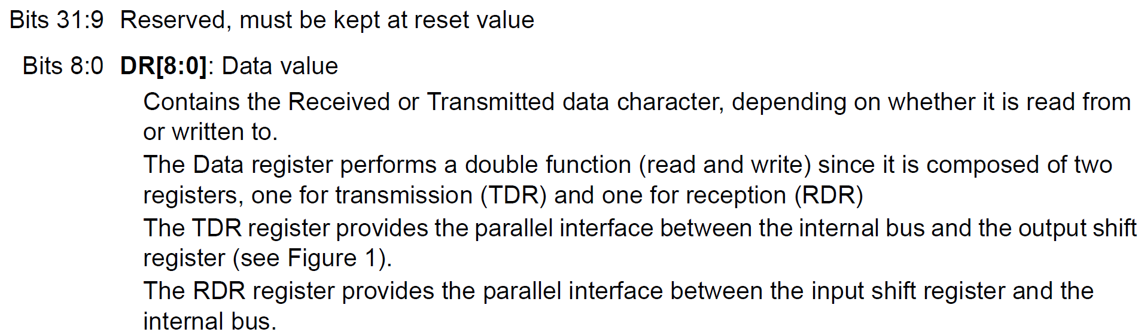
Data register (USART_DR)

Slide 7
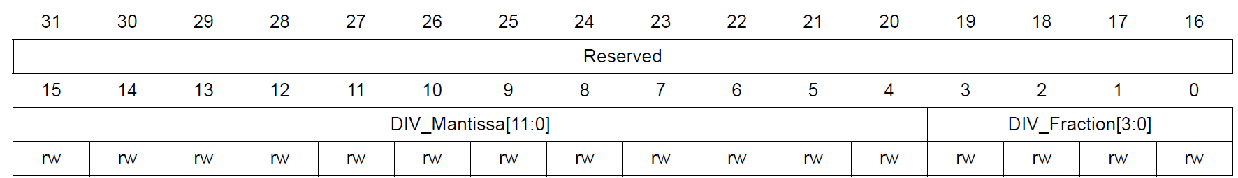
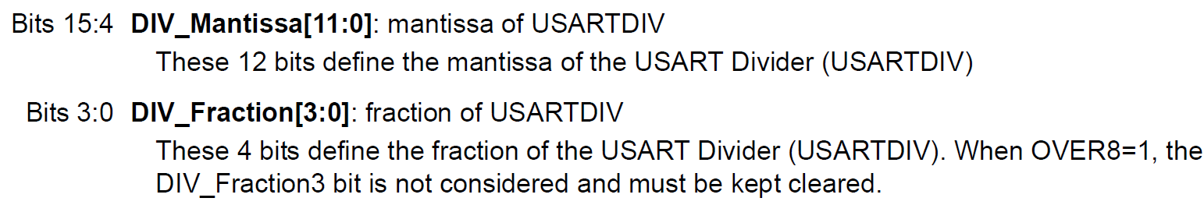
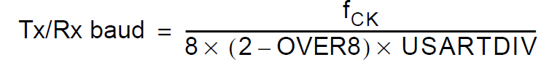
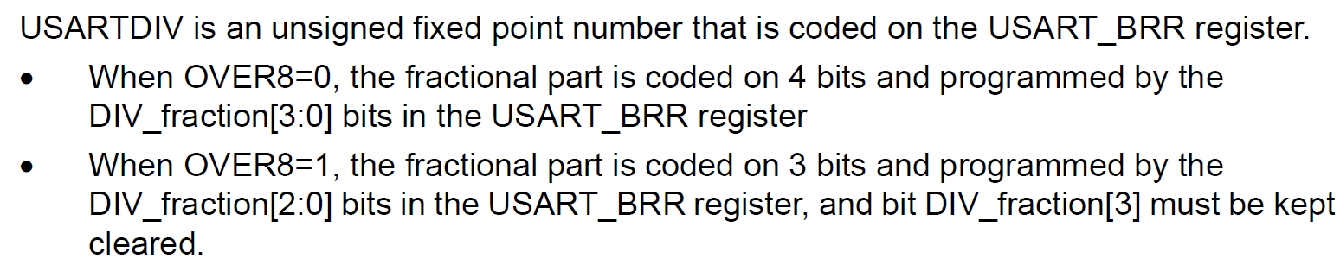
Baud rate register (USART_BRR)
The choice of 16 or 8 oversampling is done via the CR1 Control register.

Slide 8
Baud rate register (USART_BRR)
Assume the clock source of 16 MHz is fed to USART Baud rate generator with oversampling rate of 16. Find the values for the USART_BRR register for baud rates of 9,600
USARTDIV = fck / 16 x Baud
16MHz / 16 x 9,600 = 104.166.
Now, 104 = 0x68 for upper 12-bits.
For fraction part, 0.166 x 16 = 2.656 and we use 3 for the lower 4 bits.
Therefore BRR = 0x0683.

Slide 9
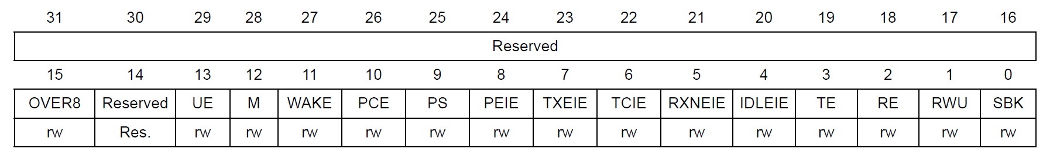
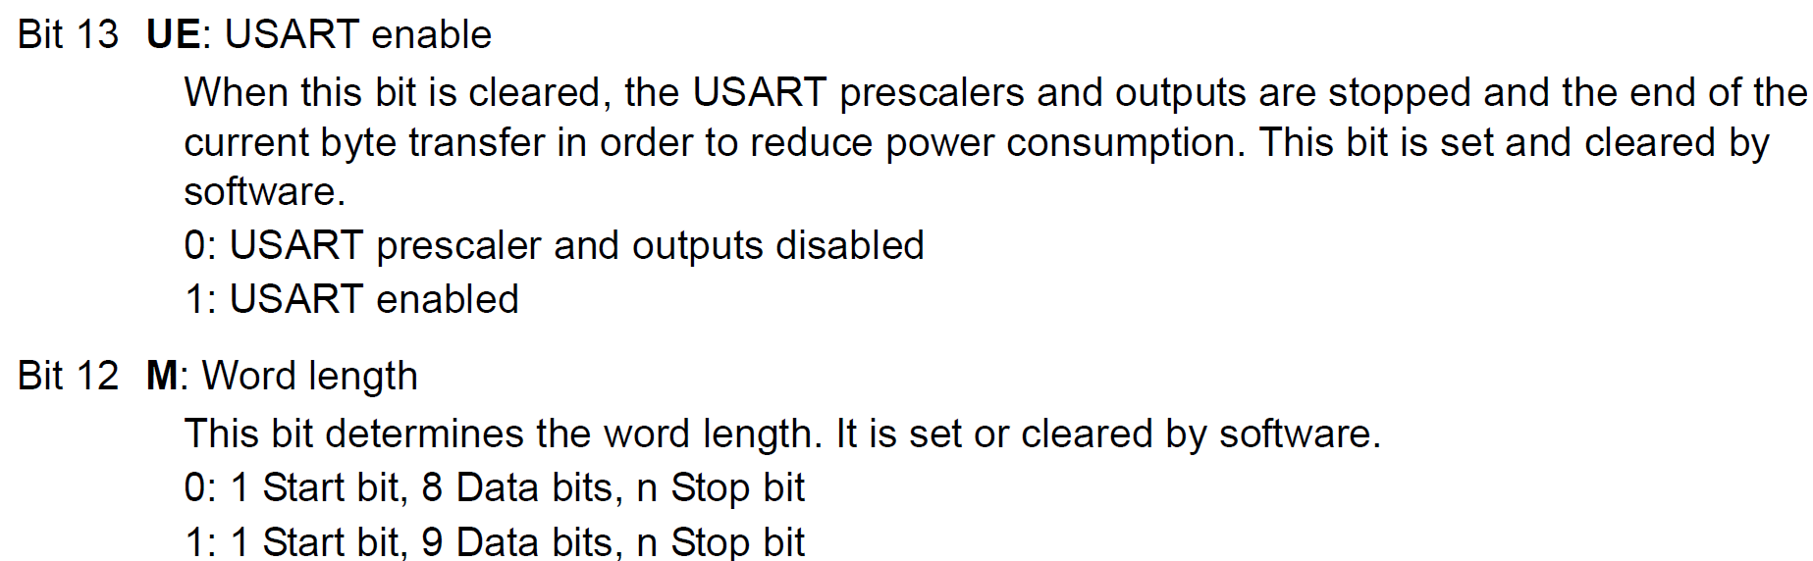
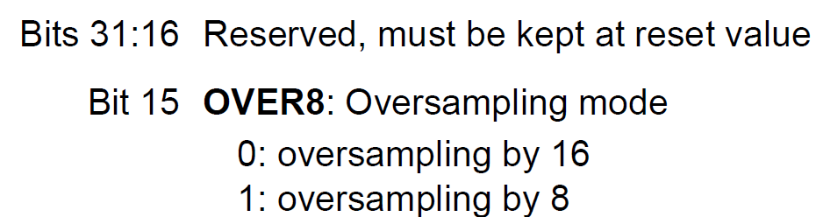
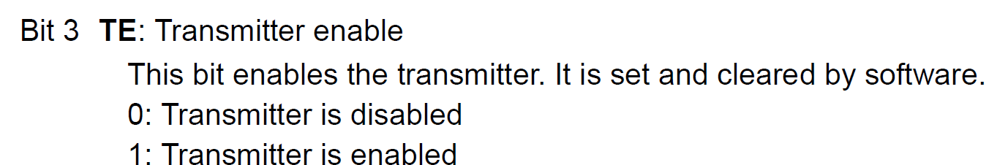
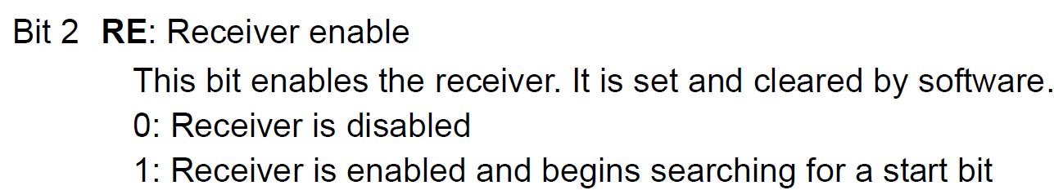
Control register 1 (USART_CR1)

Slide 10
USART2 PA2 - Tx PA3 - Rx

Slide 11
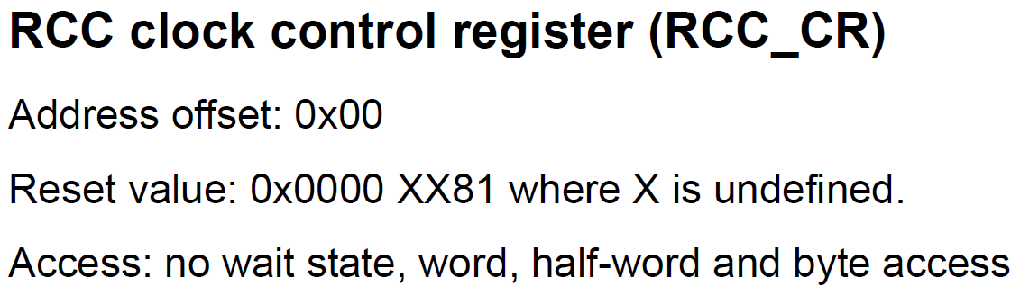
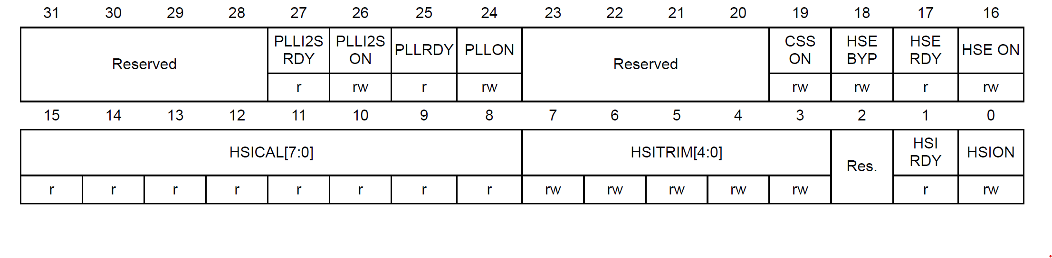
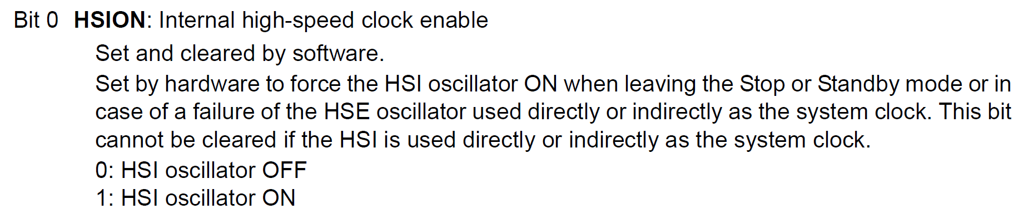
Internal Oscillator for system clock of STM32F4 (16MHz)
No need to configure this since the reset value itself enable HSION bit.

Slide 12
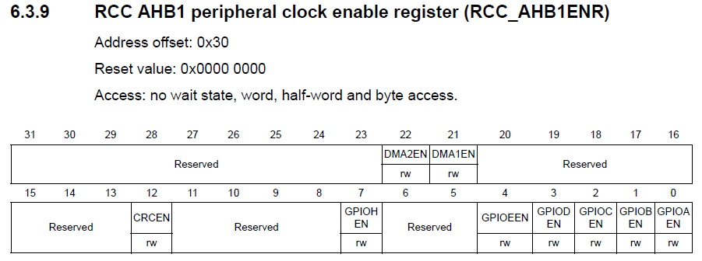
GPIO clock enabled for UART Rx Pin PA3 &Tx Pin PA2 - GPIOA
/*1. Enable GPIOA clock by Writing 1 to bit0 of AHB1ENR*/
RCC->AHB1ENR |=(1U<<0);

Slide 13
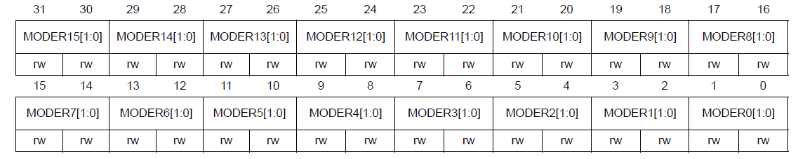
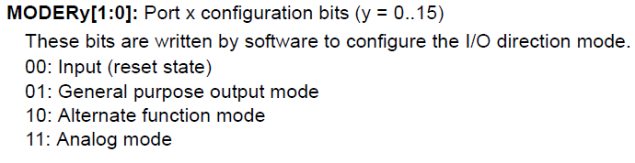
Alternate function mode select for USART2 Rx Pin PA3 & Tx Pin PA2
/* Set PA3 to alternate function mode by writing 1 to bit 7 of MODER*/
/* Set PA2 to alternate function mode by writing 1 to bit 5 of MODER*/
GPIOA->MODER |=(1U<<7);
GPIOA->MODER |=(1U<<5);

Slide 14
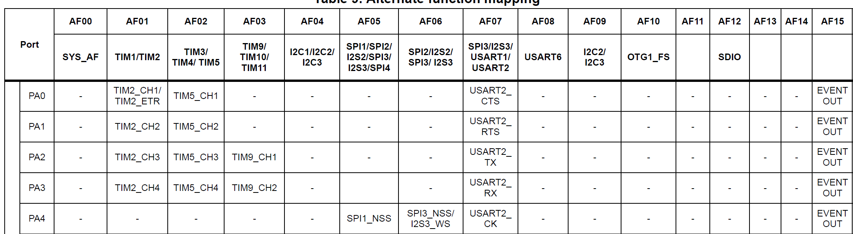
Alternate function mode select for USART2 Tx Pin PA2
Alternate function mapping

Slide 15
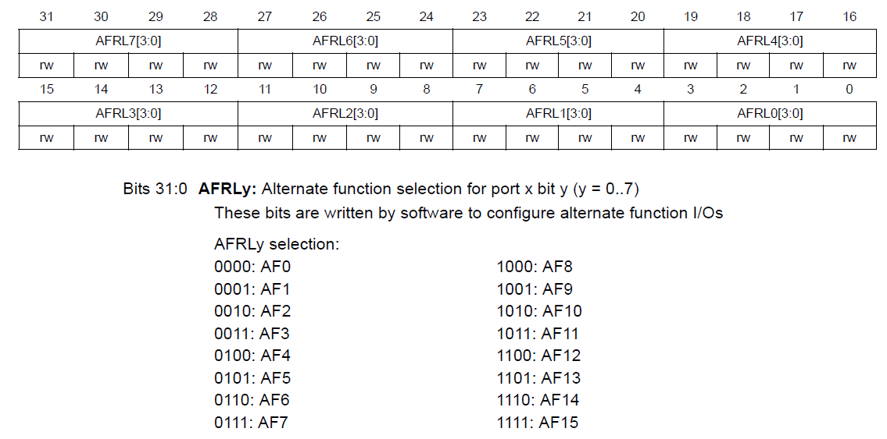
Alternate function mode select for USART2 Rx Pin PA3 & Tx Pin PA2
GPIO alternate function low register (GPIOx_AFRL) (x = A..E and H)
Rx Pin PA3
Tx Pin PA2
GPIOA->AFR[0] &= (~(1<<15));
GPIOA->AFR[0] &= (~(1<<11));
GPIOA->AFR[0] |= (1<<14) | (1<<13) | (1<<12);
GPIOA->AFR[0] |= (1<<10) | (1<<9) | (1<<8);

Slide 16
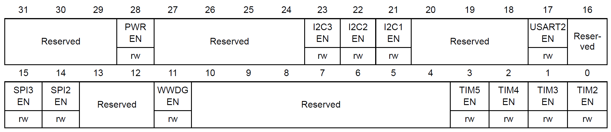
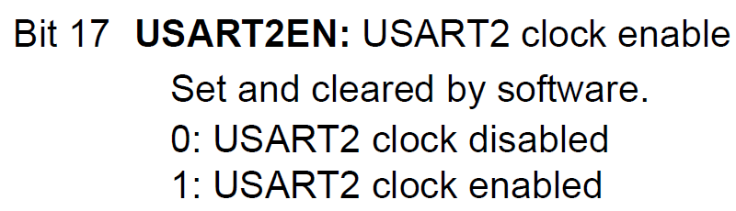
USART2 clock enable
RCC APB1 peripheral clock enable register (RCC_APB1ENR)
RCC->APB1ENR |= (1<<17);

Slide 17
Baudrate of USART2 to be 115200
OVER8=0
with oversampling rate of 16
USARTDIV = f_{ck} / (16 x baud)
16MHz / 16 x 115,200 = 8.68
Now, 08 = 0x008 for upper 12-bits.
For fraction part, 0.68 x 16 = 10.88 and we use 11 = 0xB for lower 4-bits.
Therefore BRR = 0x008B.
USART2->BRR = 0x008B;
Baudrate of USART2 to be 115200 @ 16 Mhz

Slide 18
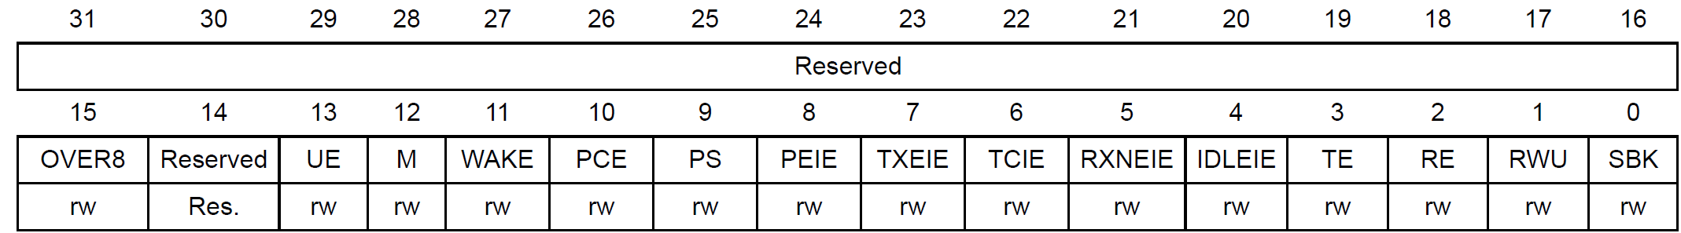
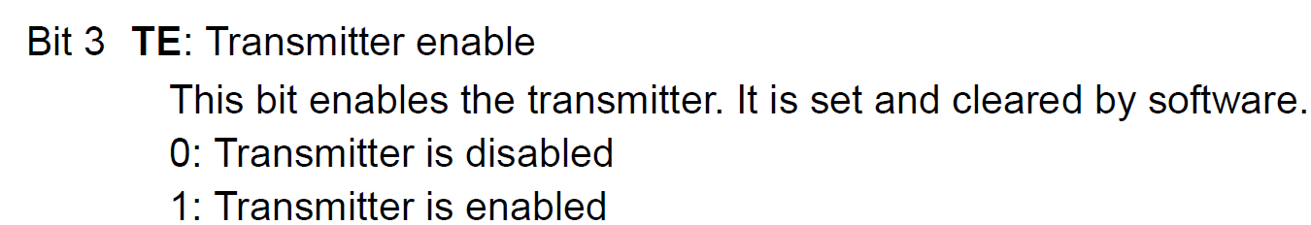
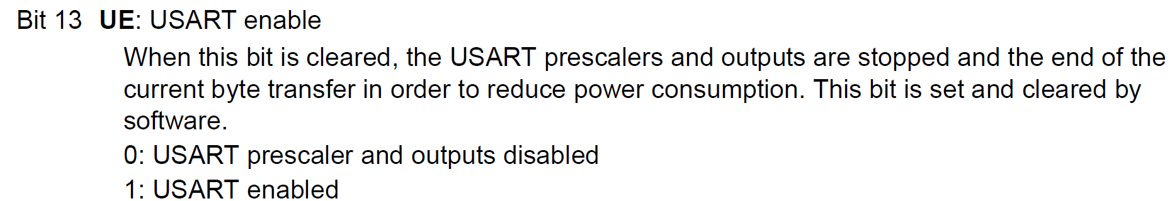
Control register 1 (USART_CR1)
USART2 enable
USART2->CR1 |= (1<<13);
Rx enable
Tx enable
USART2->CR1 |= (1<<2);
USART2->CR1 |= (1<<3);

Slide 19
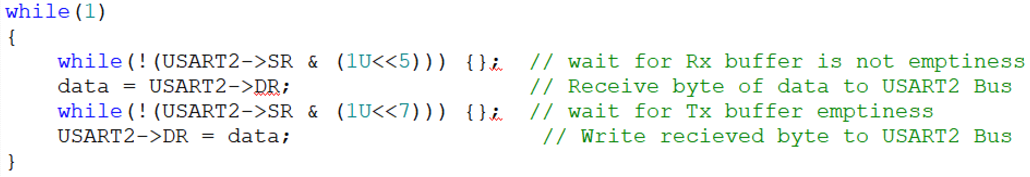
Receiving & Sending Data Through USART2 Rx &Tx

Slide 20
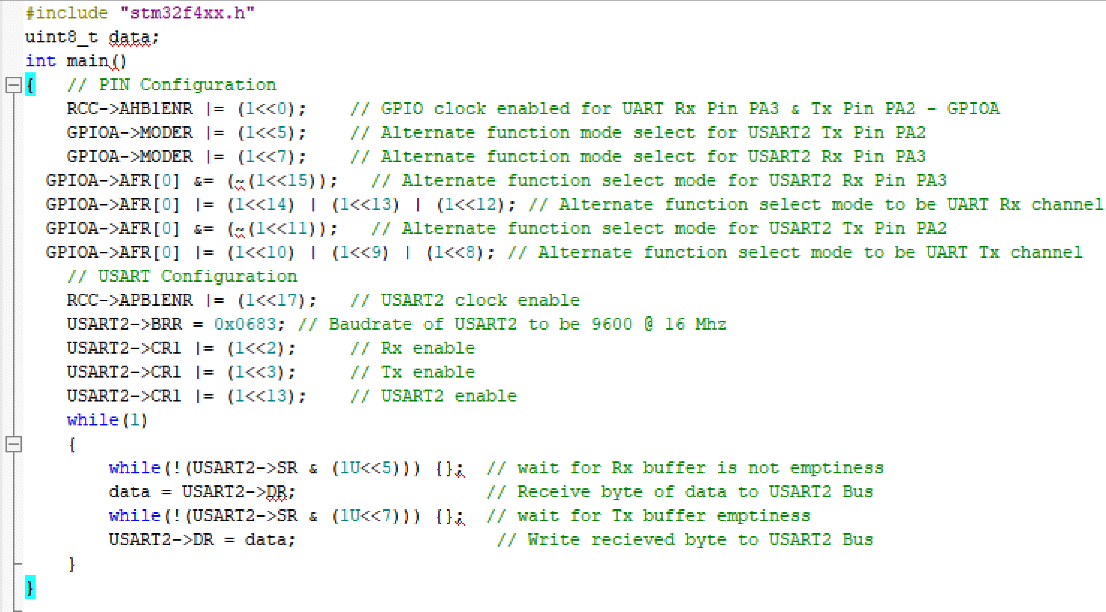
Sending Character Through USART2 Rx &Tx

Slide 21
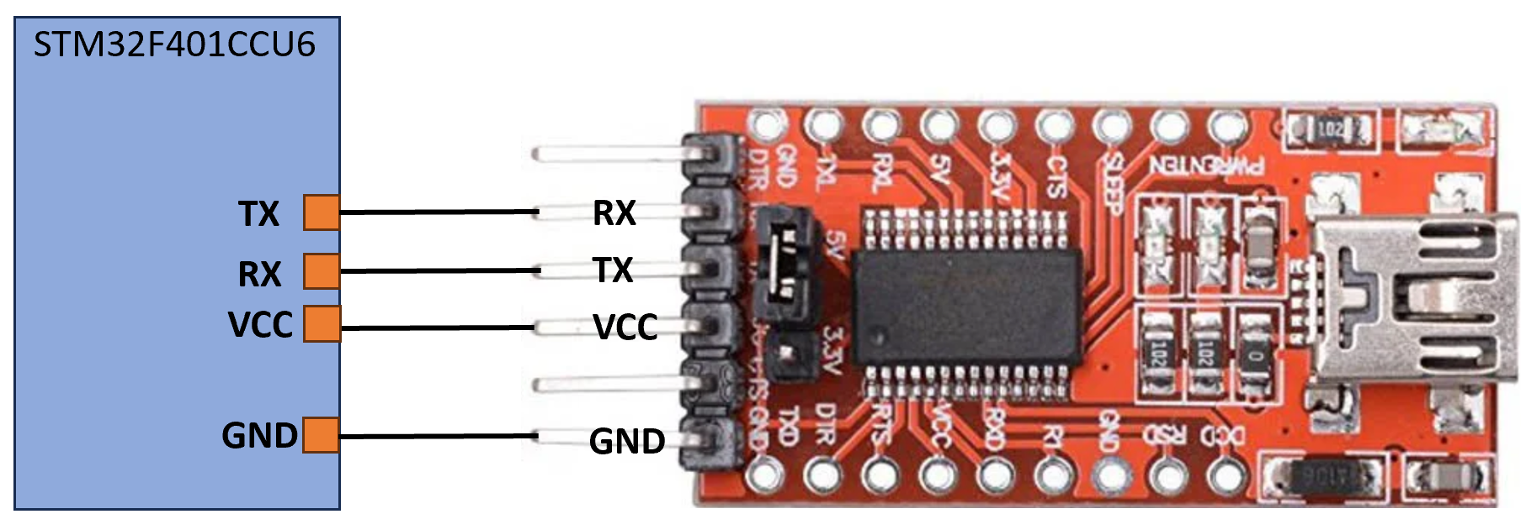
How to view UART output using FT232RL USB-to-serial UART module
Procedure to check the output
The FT232RL module is a mini USB to serial UART TTL 5V 3.3V converter circuit board designed for communication between a computer's USB port and the microcontroller's programming port.

Slide 22
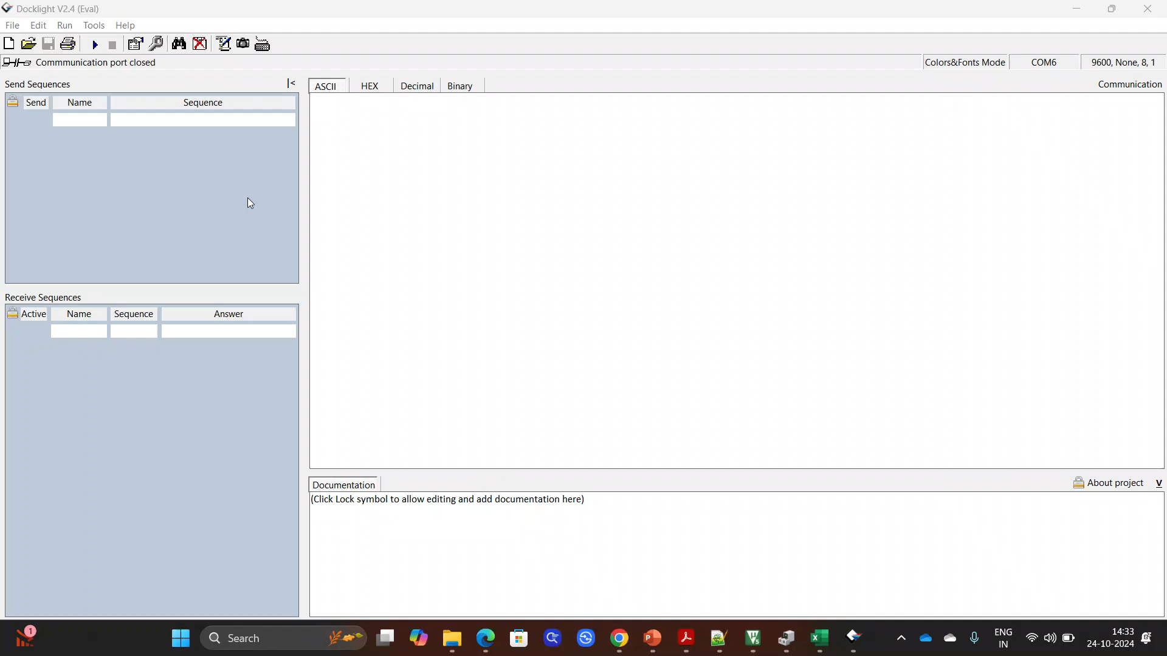
How to view UART output using HW-417 (USB to TTL converter)
Procedure to check the output
Install Docklight V2.4
https://docklight.de/downloads/
Play the Video

Slide 23
Thank You

